Slide 1
Product cluster Analysis
BORSE JATIN D.

Slide 2
Agenda
INTRODUCTION
DATA PREPROCESSING
EXPLORATORY DATA ANALYSIS (EDA)
CLUSTERING APPROACH(K-MEANS & WHY USED)
RESULTS & VISUALIZATION (CLUSTER INSIGHTS , GRAPHS)
CONCLUSION & FUTURE SCOPE

Slide 3
INTRODUCTION
This project aims to cluster products based on historical sales data using machine learning techniques. By analyzing warehouse sales, retail sales and transfers, we identify patterns that help optimize inventory management and market strategies.
KEY OBJECTIVES
1. Identify product groups with similar sales behavior.
2. Improve demand forecasting and stock optimization.
3. Detect high-value products and potential outliers in sales.
4. Use K- Means Clustering for effective segmentation.

Slide 4
data preprocessing
1. DATA CLEANING
→ Duplicate Removal :
---> The dataset had 14 duplicate entries, which were removed using drop_duplicates().
→ DROPPING UNUSED COLUMNS:
---> Columns likes “ITEM CODE” were removed to keep only relevant features.
→ HANDLING MISSING VALUES:
---> Some records had missing values in “SUPPLIER” , “ITEM CODE” and “ RETAIL SALES .
---> Missing values were either removed or imputed based in data trends.
2. FEATURE SCALING :
→ Since sales data had large variations, scaling was applied to normalize values.
→ StandardScaler were used to bring all features to a uniform scale.
3. FINAL PROCESSED DATA :
→ After preprocessing, the dataset was cleaned and structured for clustering.
→ The transformed data was then used for K-Means Clustering.

Slide 5
EXPLORATORY DATA ANALYSIS (EDA)
1. Retail Sales Distribution (Box Plot Analysis)
The majority of retail sales values are concentrated in the lower range, indicating that most products have moderate sales.
A long right whisker and multiple outliers suggest a positively skewed distribution, meaning some products experience exceptionally high sales.
The presence of numerous outliers highlights high-value products or possible data anomalies that need further investigation.
2. Correlation Analysis (If performed in the project)
Sales trends indicate a strong correlation between warehouse sales and retail sales.
Transfers between warehouses also show a consistent pattern, which can be used to predict stock demand.
3. Visualizations Used:
Box Plot – Analyzed sales distribution and detected outliers.
(If applicable) Heatmaps/Histograms/Scatter Plots – Examined relationships between different sales parameters.
Key Takeaways:
The analysis highlights key trends that can optimize stock management and sales strategies.
Identifying high-performing and underperforming products can help in strategic pricing and promotional decisions.

Slide 6
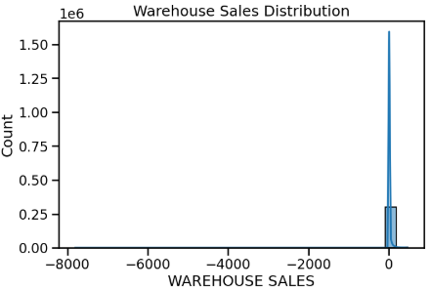
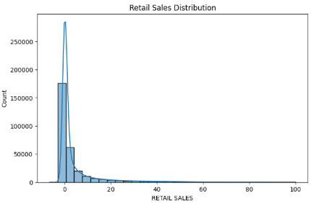
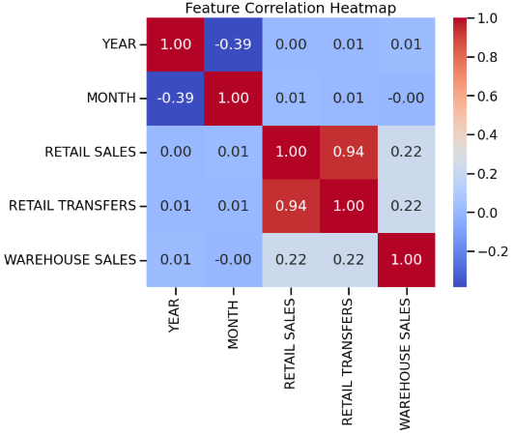
→ The histogram below shows the distribution of RETAIL SALES , Warehouse Sales with a kernel density estimate (KDE) curve.
→ This heatmap visualizes the correlation between numerical features, showing a **strong positive correlation (0.94) between retail sales and retail transfers**, indicating a direct relationship. The **negative correlation (-0.39) between year and month suggests a seasonal pattern** in the dataset.

Slide 7
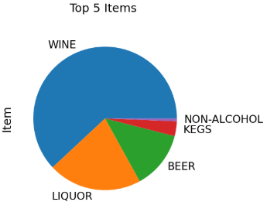
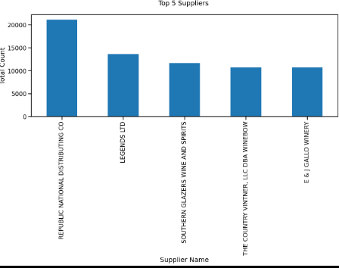
→ The pie chart below displays the Top 5 Items based on the total count of items
→ Wine is the most sold item, followed by Liquor and Beer.
→The bar chart below displays the Top 5 Suppliers based on the total count of items supplied.
→ From the analysis, the top supplier is Republic National Distributing Co, contributing significantly more than the rest. Other notable suppliers include Legends Ltd, Southern Glazers Wine and Spirits, The Country Vintner LLC DBA Winebow, and E & J Gallo Winery.

Slide 8
CLUSTERING APPROACH(K-MEANS & WHY USED)
Why Clustering?
Groups products based on sales patterns.
Helps in identifying high, medium, and low-performing products.
Useful for inventory management and sales optimization.
Why K-Means?
Works well with large datasets.
Creates clear and distinct clusters of products.
Faster and more efficient than other clustering techniques.
Steps in Clustering:
Data Preprocessing – Scaled sales data using StandardScaler & MinMaxScaler.
Finding Clusters – Used Elbow Method to determine the best number of clusters.
Applying K-Means – Grouped products based on sales trends.
Analysis – Identified different product groups for better decision-making.
Key Insight:
K-Means clustering helps in better inventory planning and sales strategy by segmenting products effectively.

Slide 9
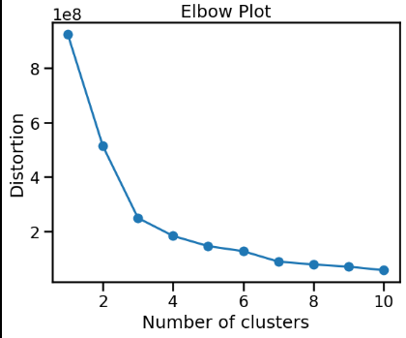
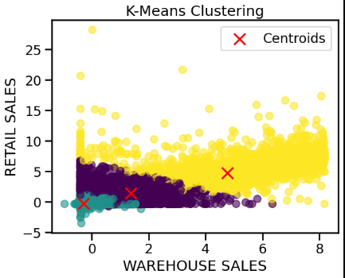
RESULTS & VISUALIZATION (CLUSTER INSIGHTS , GRAPHS)
Clustering Insights:
Optimal Clusters Found: 3 (using Elbow Method).
Cluster Distribution: Majority products fall into Cluster 0 and Cluster 1, while high-performing products belong to Cluster 2
Cluster Characteristics:
Cluster 0: Low sales, frequent transfers – slow-moving products.
Cluster 1: Moderate sales, stable transfers – average-performing products.
Cluster 2: High warehouse sales, fewer retail transfers – bulk stock items.
Key Insight:
K-Means clustering helps in better inventory planning and sales strategy by segmenting products effectively.

Slide 10
CONCLUSION & FUTURE SCOPE
Conclusion:
The project successfully applied K-Means clustering to categorize products based on historical sales data.
Data preprocessing and exploratory analysis provided key insights into sales patterns and inventory trends.
The clustering results identified distinct product groups, helping in inventory optimization and sales strategy planning.
Visualization techniques, including scatter plots and box plots, helped interpret sales distribution and cluster characteristics.
The study emphasizes the importance of data-driven decision-making for effective retail and warehouse management.
Future Scope:
Advanced Clustering Techniques: Future improvements can explore Hierarchical Clustering or DBSCAN for more refined segmentation.
Time-Series Analysis: Incorporating time-series forecasting techniques like ARIMA or LSTM for demand prediction.
Real-time Inventory Monitoring: Implementing a real-time clustering model to adapt dynamically to sales trends.
Integration with Business Strategies: Using clustering results for personalized marketing, dynamic pricing, and optimized warehouse distribution.
Feature Engineering: Adding more product attributes, such as customer preferences and seasonal variations, to improve clustering accuracy.
By implementing these improvements, businesses can enhance efficiency, profitability, and customer satisfaction using data-driven insights.
.

Slide 11
QUESTION

Slide 12
Thank You!

